Slide 1
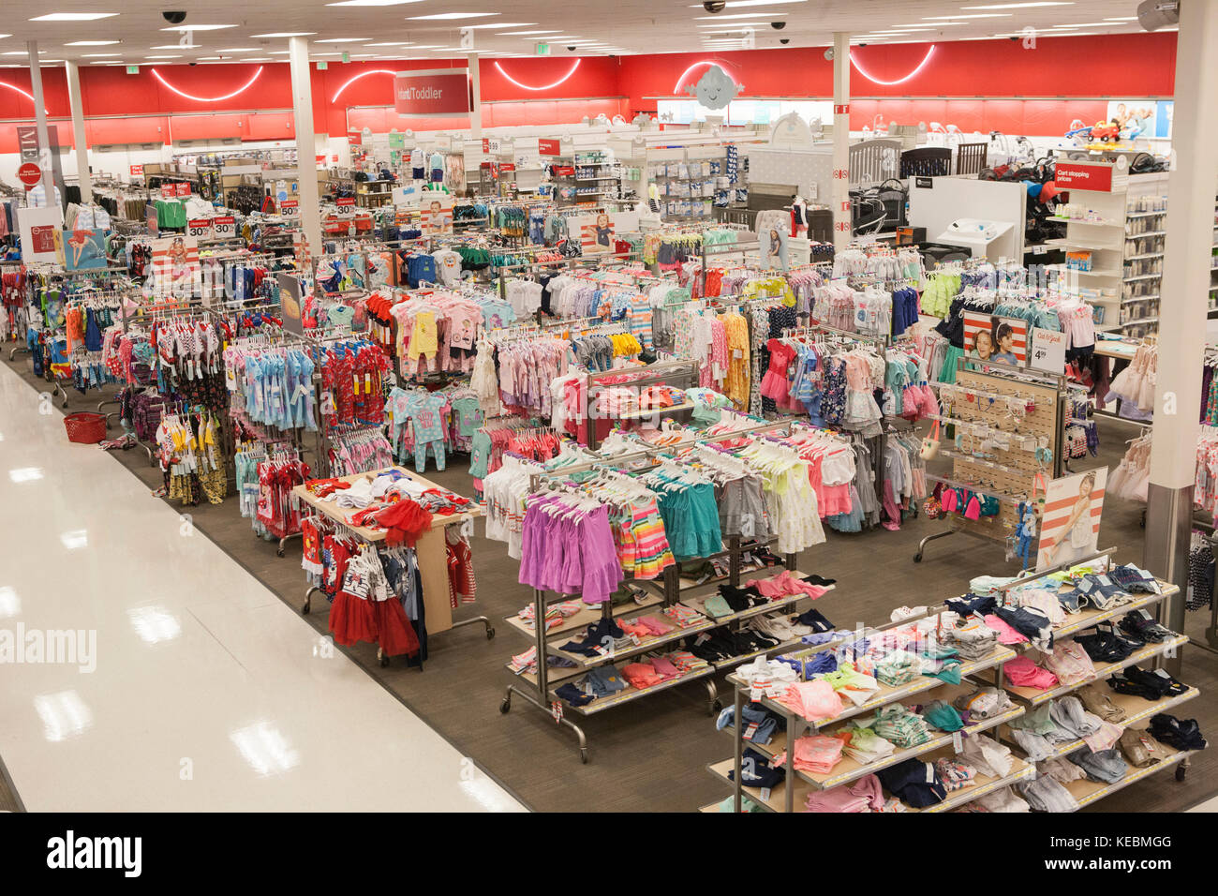

Slide 2


Slide 3
What is branding?

Slide 4
Creating a distinct identity for our organization
May include name and logo, visual design, mission, and tone of voice
Indicates who we are and how we present to the world

Slide 5
Creating a distinct identity for our organization
May include name and logo, visual design, mission, and tone of voice
Indicates who we are and how we present to the world

Slide 6
Creating a distinct identity for our organization
May include name and logo, visual design, mission, and tone of voice
Indicates who we are and how we present to the world

Slide 7





Slide 8

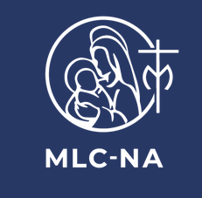


Slide 9
Why does branding matter for our new community?
Creates a concrete representation of who we are as a new community
Team colors - personally identifying and unites us around common “thing”
Extends an invitation to others - What are they being invited into? How does it feel? What tone does it take?
To continue our community, we must invite others in - and that starts with clearly letting people know who we are and what we do

Slide 10



What is our current brand?

Slide 11
What are next steps for our branding task force?
Naming our new community
Soliciting community feedback on visual design and logo
  Engaging a designer to create a logo and brand guidelines
Sharing recommendations for community name and visual brand
Finalizing (and revisiting) our mission, vision, values
Notes:
Power of naming - end times vs. hope

